Slide 1
Set and Dictionary

Slide 2
Sets
Sets are used to store multiple items in a single variable.
Set is one of 4 built-in data types in Python used to store collections of data
A set is a collection which is unordered, unchangeable*, and unindexed.
Unordered: Unordered means that the items in a set do not have a defined order.
Set items can appear in a different order every time you use them, and cannot be referred to by index or key.
Unchangeable:
Set items are unchangeable, meaning that we cannot change the items after the set has been created.
Once a set is created, you cannot change its items, but you can remove items and add new items.
Duplicates Not Allowed: Sets cannot have two items with the same value.
Note: Set items are unchangeable, but you can remove items and add new items.
Note: Sets are unordered, so you cannot be sure in which order the items will appear.
thisset = {"apple", "banana", "cherry", "apple"}
Output:{'banana', 'cherry', 'apple’}

Slide 3
Note: The values True and 1 are considered the same value in sets, and are treated as duplicates:
thisset = {"apple", "banana", "cherry", True, 1, 2}
Output: {True, 2, 'banana', 'cherry', 'apple’}
print(len(thisset))
set1 = {"abc", 34, True, 40, "male"}
print(type(myset))

Slide 4
Access Items You cannot access items in a set by referring to an index or a key. But you can loop through the set items using a for loop, or ask if a specified value is present in a set, by using the in keyword.
.
thisset = {"apple", "banana", "cherry"} for x in thisset: print(x)
print("banana" in thisset)#Check if "banana" is present in the set.
Note:Once a set is created, you cannot change its items, but you can add new items.
thisset.add("orange")# add items
To add items from another set into the current set, use the update() method
thisset = {"apple", "banana", "cherry"} tropical = {"pineapple", "mango", "papaya"} thisset.update(tropical) print(thisset)
The object in the update() method does not have to be a set, it can be any iterable object (tuples, lists, dictionaries etc.
thisset = {"apple", "banana", "cherry"} mylist = ["kiwi", "orange"] thisset.update(mylist) print(thisset)

Slide 5
Remove Item
:
.
thisset = {"apple", "banana", "cherry"} thisset.remove("banana")
print(thisset)
Note: If the item to remove does not exist, remove() will raise an error
thisset.discard("banana")# Remove "banana" by using the discard() method
x = thisset.pop()# this method will remove a random item
thisset.clear()#The clear() method empties the set.
del thisset #The del keyword will delete the set completely:

Slide 6
Join Sets
.
There are different methods to join sets
1)The union() method returns a new set with all items from both sets:
set1 = {"a", "b" , "c"} set2 = {1, 2, 3} set3 = set1.union(set2) print(set3)
2)The update() method inserts the items in set2 into set1: set1.update(set2)
Note: Both union() and update() will exclude any duplicate items
3)intersection_update():Keep the items that exist in both set x, and set y:
x = {"apple", "banana", "cherry"} y = {"google", "microsoft", "apple"} x.intersection_update(y) print(x)
4) intersection():method will return a new set, that only contains the items that are present in both sets.
z = x.intersection(y)
5) symmetric_difference_update()# method will keep only the elements that are NOT present in both sets
x.symmetric_difference_update(y)
#Note : Keep All, But NOT the Duplicates
6) symmetric_difference() #method will return a new set, that contains only the elements that are NOT present in both sets.
z = x.symmetric_difference(y)

Slide 7
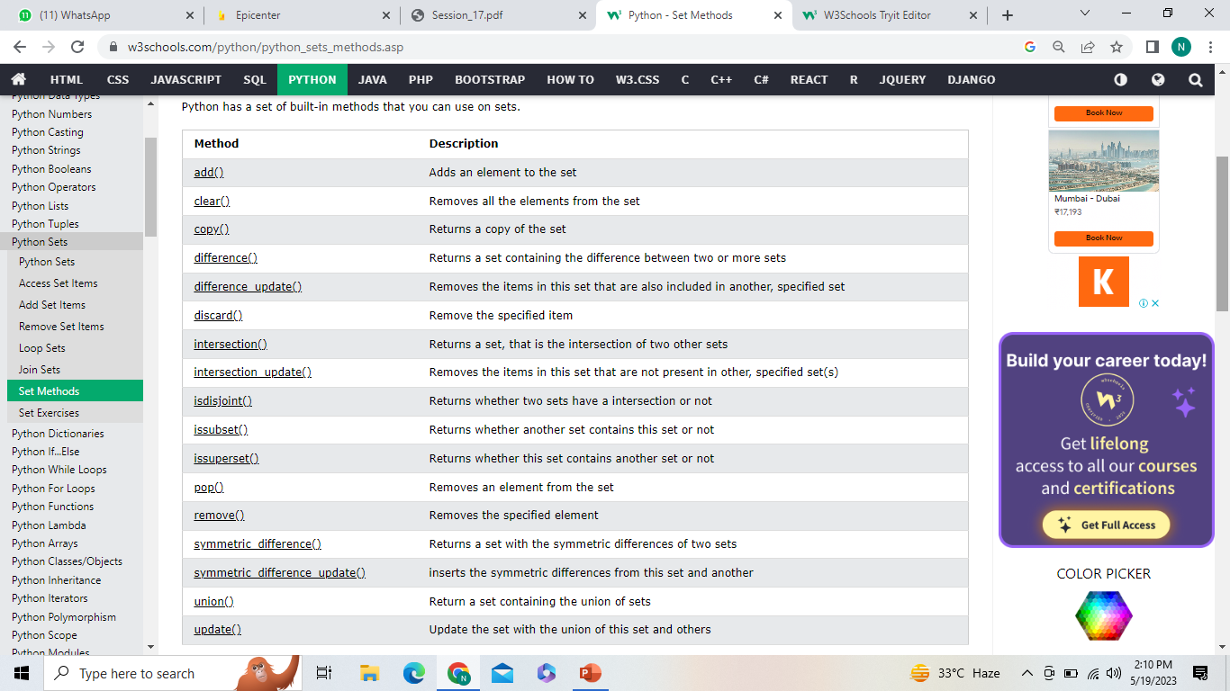
Set Methods

Slide 8
Extra
Metods :
https://www.w3schools.com/python/python_sets_methods.asp
Exercise:
https://www.w3resource.com/python-exercises/sets/

Slide 9
Set exercise:
Write a python program and use a set instead of a list. Take the input from the users until users select to discontinue. And print all the unique values at the end.
Hint: Use a while loop to repeat the main program and use the set to store the value.

Slide 10
Answer:
fruits = set()
while(True):
value = input("Enter the name of the fruit : ")
fruits.add(value)
ch = int(input("Enter 0 to quit or any key to continue :"))
if ch == 0 :
break
for i in fruits:
print(i )

Slide 11
Stimulants:
1) What will be the output of the following Python code?
a = [5,5,6,7,7,7]
b = set(a)
def test(lst):
if lst in b:
return 1
else:
return 0
for i in filter(test, a):
print(i,end=" ")
a) 5 5 6
b) 5 6 7
c) 5 5 6 7 7 7
d) 5 6 7 7 7
Answer: c

Slide 12
2) What will be the output of the following Python code?
a={5,4}
b={1,2,4,5}
a<b
a) {1,2} b) True c) False d) Invalid operation
Answer: b
If a={5,6,7,8}, which of the following statements is false? a) print(len(a)) b) print(min(a)) c) a.remove(5) d) a[2]=45
Explanation: There exists add method for set data type. However 5 isn’t added again as set consists of only non-duplicate elements and 5 already exists in the set. Execute in python shell to verify.
4) What will be the output of the following Python code?
a={4,5,6}
b={2,8,6}
a-b
a) {4,5} b) {6} c) Error as unsupported operand type for set data type d) Error as the duplicate item 6 is present in both sets
Explanation: – oAnswer: aperator gives the set of elements in set a but not in set b.

Slide 13
5) Is the following Python code valid?
a={3,4,{7,5}}
print(a[2][0])
a) Yes, 7 is printed b) Error, unhashable type: 'set'
c) Error, subsets aren’t allowed d) Yes, {7,5} is printed
Answer: c
6) Is a subset of b?
a = {4,5} b = {1,2,3,4,5} a.issubset(b)
b.issubset(a)
a)True
b)False Answer: c

Slide 14
Dictionary

Slide 15
Dictionary
Dictionaries are used to store data values in key:value pairs.
A dictionary is a collection which is ordered*, changeable and do not allow duplicates.
Dictionaries are written with curly brackets
thisdict = { "brand": "Ford", "model": "Mustang", "year": 1964 } print(thisdict)
# can be referred to by using the key name.
thisdict = { "brand": "Ford", "model": "Mustang", "year": 1964 } print(thisdict["brand"])
# Duplicate values will overwrite existing values:
thisdict = { "brand": "Ford", "model": "Mustang", "year": 1964, "year": 2020 } print(thisdict)

Slide 16
Accessing Items:
.
You can access the items of a dictionary by referring to its key name, inside square brackets:
thisdict = { "brand": "Ford", "model": "Mustang", "year": 1964 } x = thisdict["model"]
Or
x = thisdict.get("model")#There is also a method called get() that will give you the same result
x = thisdict.keys()# The keys() method will return a list of all the keys in the dictionary
car["color"] = "white“
x = thisdict.values()# The values() method will return a list of all the values in the dictionary
car["year"] = 2020 # Make a change in the original dictionary, and see that the values list gets updated as well
x = thisdict.items() #The items() method will return each item in a dictionary, as tuples in a list.

Slide 17
Change Values:
:
:
:
thisdict["year"] = 2018#Change the "year" to 2018
thisdict.update({"year": 2020})#Update the "year" of the car by using the update() method.
thisdict["color"] = "red“#Adding an item to the dictionary is done by using a new index key and assigning a value to it.
thisdict.update({"color": "red"})#Update Dictionary
thisdict.pop("model")#The pop() method removes the item with the specified key name:
thisdict.popitem()#The popitem() method removes the last inserted item (in versions before 3.7, a random item is removed instead):
del thisdict["model"]# The del keyword removes the item with the specified key name
thisdict.clear():The clear() method empties the dictionary
for x in thisdict:
print(x) #Print all key names in the dictionary, one by one(loop)
for x in thisdict.values():
print(x)# You can also use the values() method to return values of a dictionary
for x in thisdict.keys():#You can use the keys() method to return the keys of a dictionary:
for x, y in thisdict.items():# Loop through both keys and values, by using the items() method
print(x, y)
mydict = thisdict.copy()# Make a copy of a dictionary with the copy() method
mydict = dict(thisdict)#Make a copy of a dictionary with the dict() function:

Slide 18
Nested Dictionaries
Create a dictionary that contain three dictionaries:
myfamily = { "child1" : { "name" : "Emil", "year" : 2004 }, "child2" : { "name" : "Tobias", "year" : 2007 }, "child3" : { "name" : "Linus", "year" : 2011 } }
print(myfamily)

Slide 19
Create three dictionaries, then create one dictionary that will contain the other three dictionaries:
child1 = { "name" : "Emil", "year" : 2004 } child2 = { "name" : "Tobias", "year" : 2007 } child3 = { "name" : "Linus", "year" : 2011 } myfamily = { "child1" : child1, "child2" : child2, "child3" : child3 }
print(myfamily)
print(myfamily["child2"]["name"])#Print the name of child 2:

Slide 20
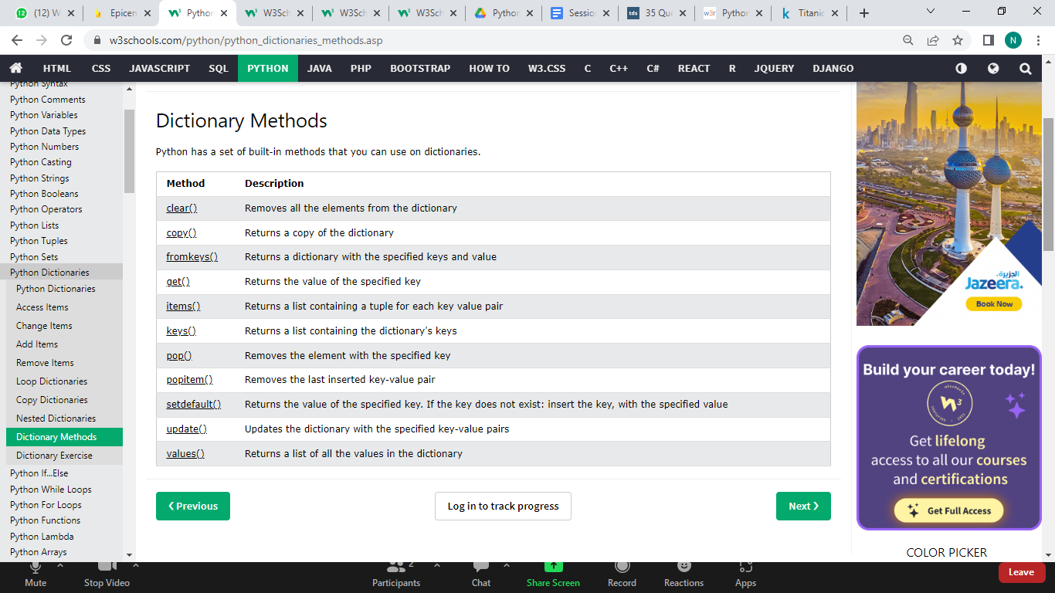
Dictionary Methods Python has a set of built-in methods that you can use on dictionaries.

Slide 21
Problem statements: 1)Write a python program to help A and B to store the marks inside the dictionary. Print the dictionary with the total marks of the student.
2) A successfully stored his marks inside the dictionary. Now he wants to put all the data of his class inside a nested dictionary.Write the program for the nested dictionary.

Slide 22
Solutions:
1) score = {}
num = int(input("Enter the number of subjects : "))
for i in range(num):
subject = input("Enter the name of the subject :")
marks = int(input("Enter the marks :"))
score[subject] = marks
print(score)
print("Total marks :" , end=" ")
print(sum(score.values()))
or another solution in the next page
2) # Marks of first student
marks1 = {"Math" : 100 , "Science" : 99 , "English" : 92}
# Marks of second student
marks2 = {"Math" : 90 , "Science" : 89 , "English" : 99}
# Marks of third student
marks3 = {"Math" : 94 , "Science" : 91 , "English" : 95}
# Marks of all the students with student names
students = {"student1" : marks1 , "student2" : marks2 , "stdents3" : marks3}
print(students)

Slide 23
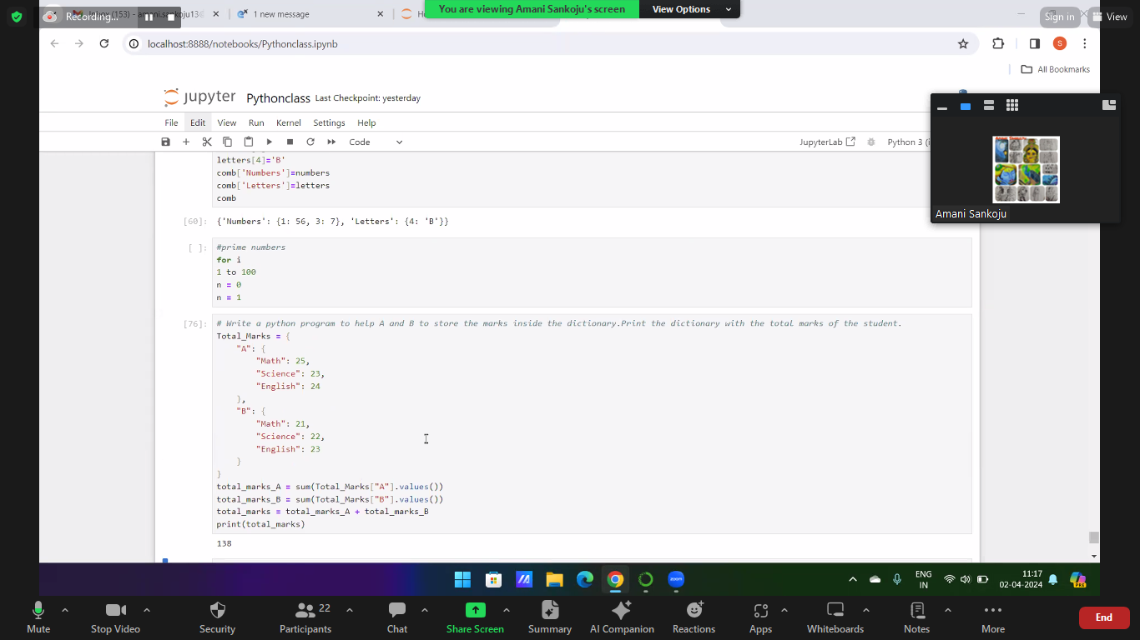

Slide 24
PYTHON DICTIONARY
Stimulants

Slide 25
Stimulants
1. Which of the following statements create a dictionary?
a) d = {}
b) d = {“john”:40, “peter”:45}
c) d = {40:”john”, 45:”peter”}
d) All of the mentioned
2. Read the code shown below carefully and pick out the keys?
d = {"john":40, "peter":45}
a) “john”, 40, 45, and “peter”
b) “john” and “peter”
c) 40 and 45
d) d = (40:”john”, 45:”peter”)
3. What will be the output?
d = {"john":40, "peter":45}
"john" in d
a) True
b) False
c) None
d) Error

Slide 26
Stimulants
4. What will be the output?
d1 = {"john":40, "peter":45}
d2 = {"john":466, "peter":45}
d1 == d2
a) True
b) False
c) None
d) Error
5. What will be the output?
d = {"john":40, "peter":45}
print(list(d.keys()))
a) [“john”, “peter”].
b) [“john”:40, “peter”:45].
c) (“john”, “peter”)
d) (“john”:40, “peter”:45)

Slide 27
Stimulants
6. Suppose d = {“john”:40, “peter”:45}, what happens when we try to retrieve a value using the expression d[“susan”]?
a) Since “susan” is not a value in the set, Python raises a KeyError exception
b) It is executed fine and no exception is raised, and it returns None
c) Since “susan” is not a key in the set, Python raises a KeyError exception
d) Since “susan” is not a key in the set, Python raises a syntax error
7. What is the output of the following snippet of code?
>>> a={1:"A",2:"B",3:"C"}
>>> del a
a) method del doesn’t exist for the dictionary
b) del deletes the values in the dictionary
c) del deletes the entire dictionary
del deletes the keys in the dictionary
8. What is the output of the following snippet of code?
test = {1:'A', 2:'B', 3:'C'}
test = {}
print(len(test))
a) 0
b) None
c) 3
d) An exception is thrown

Slide 28
Stimulants
9. What is the output of the following snippet of code?
numbers = {}
letters = {}
comb = {}
numbers[1] = 56
numbers[3] = 7
letters[4] = 'B'
comb['Numbers'] = numbers
comb['Letters'] = letters
print(comb)
a) Error, dictionary in a dictionary can’t exist
b) ‘Numbers’: {1: 56, 3: 7}
c) {‘Numbers’: {1: 56}, ‘Letters’: {4: ‘B’}}
d){‘Numbers’: {1: 56, 3: 7}, ‘Letters’: {4: ‘B’}}

